Slide 1

HR Attrition Data Analysis

Slide 2
Project Objectives:-
1.Data Cleaning
2. Exploratory Data Analysis
3.Data Visualization

Slide 3
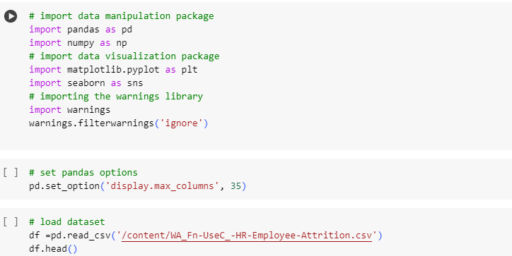
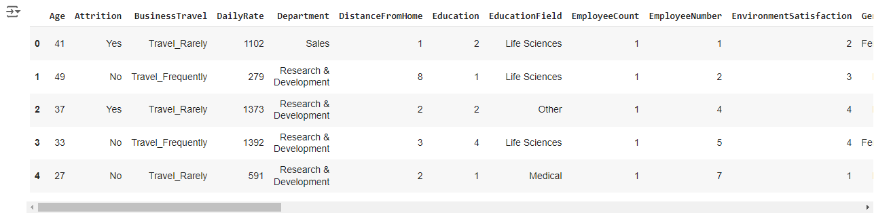
Data Cleaning:-

Slide 4
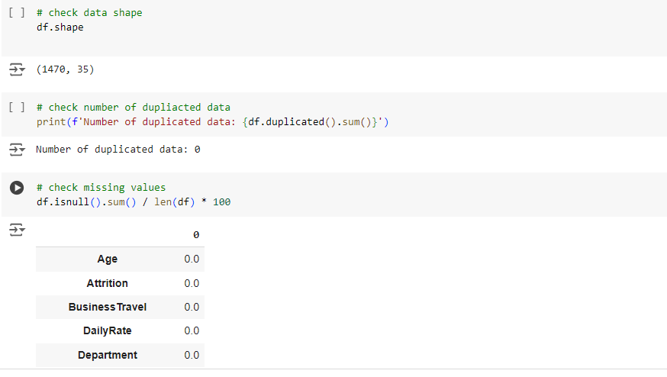

Slide 5
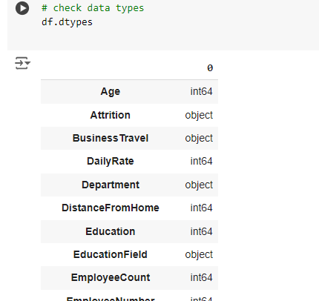
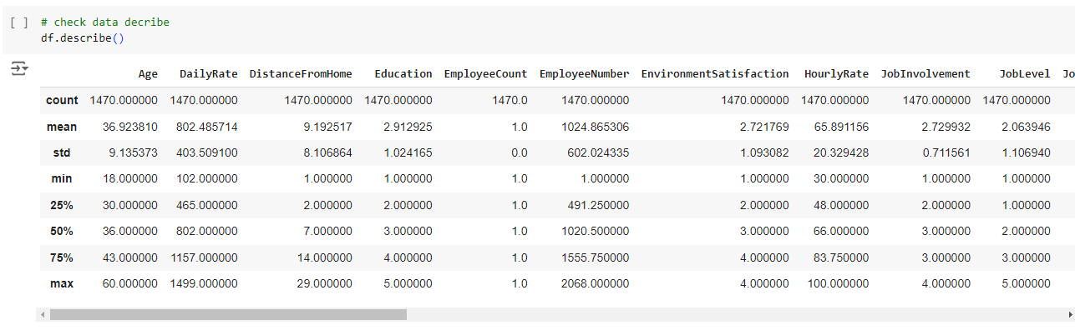

Slide 6
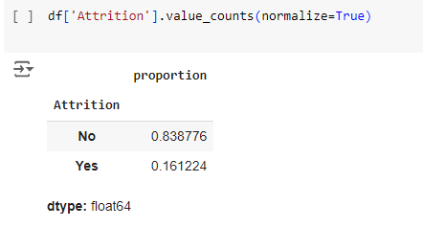

Slide 7
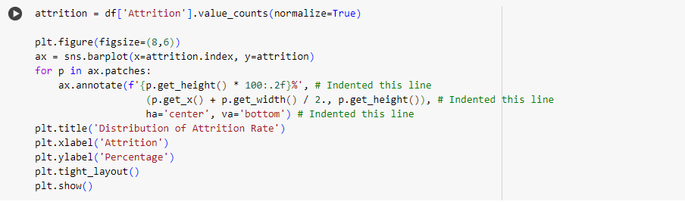
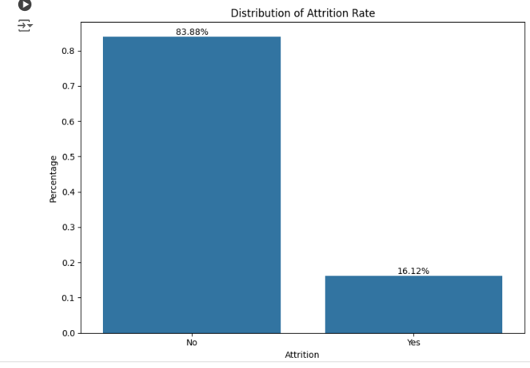

Slide 8
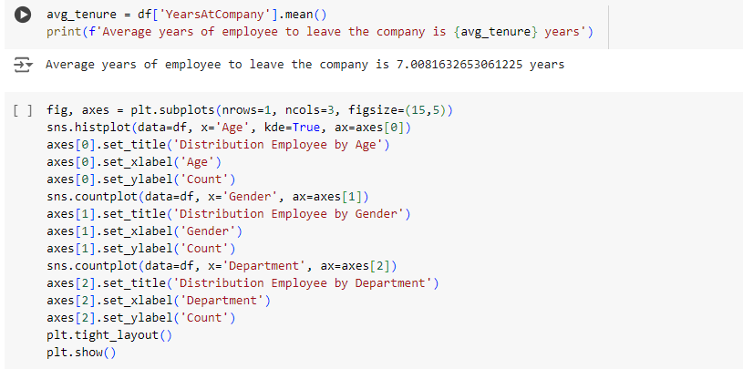
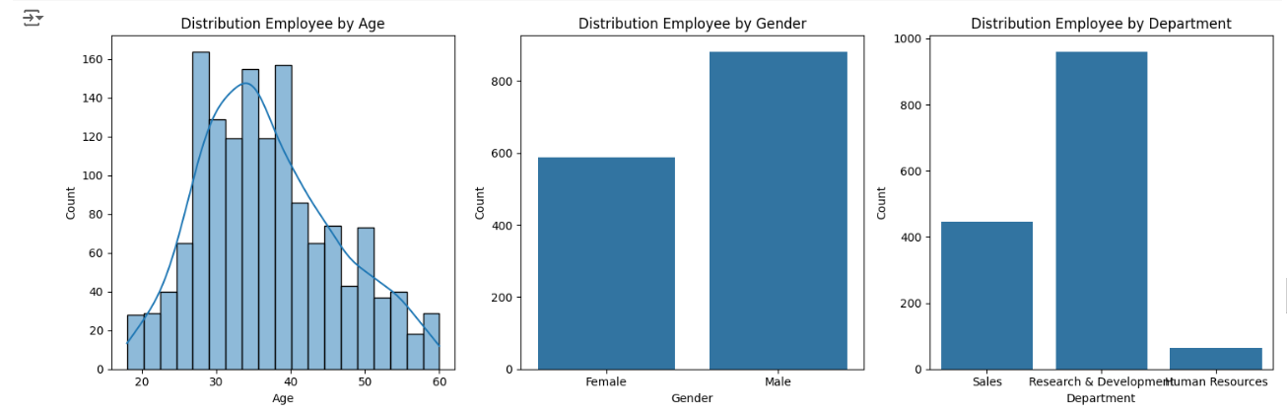

Slide 9
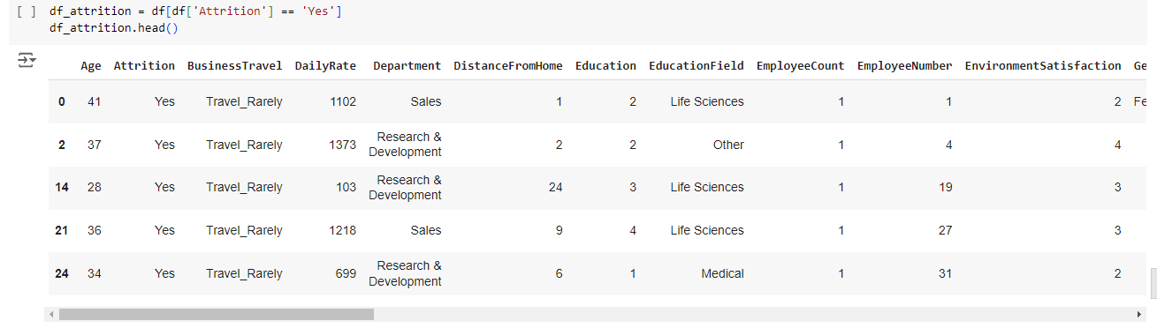

Slide 10
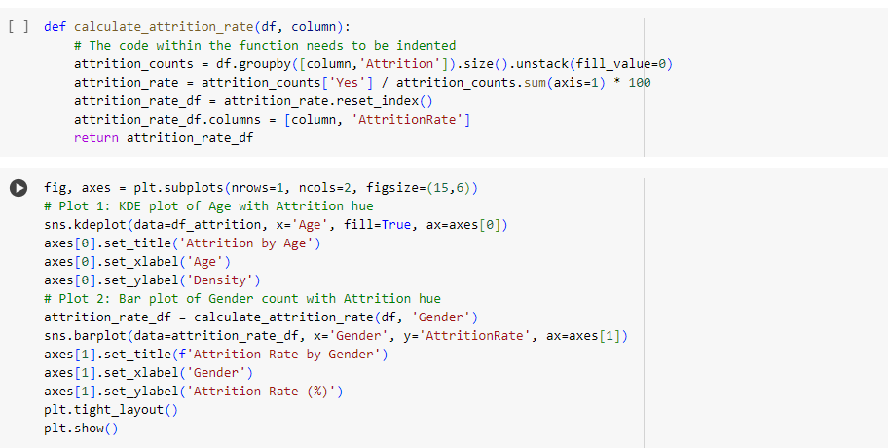
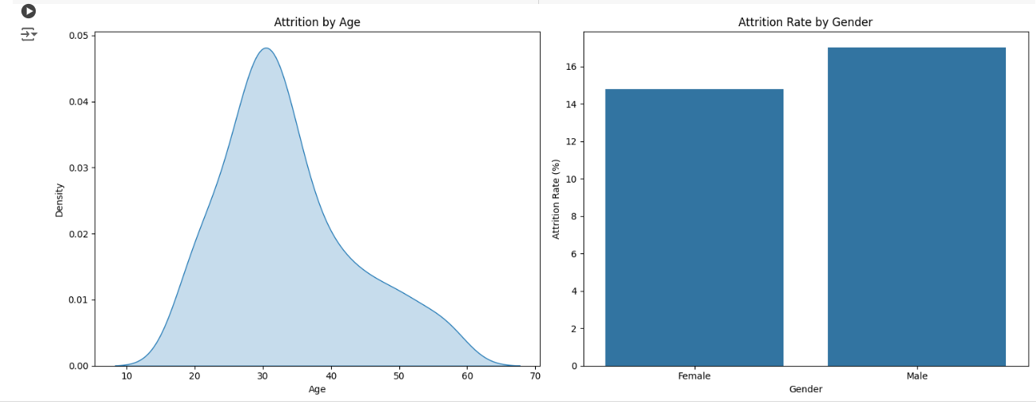

Slide 11
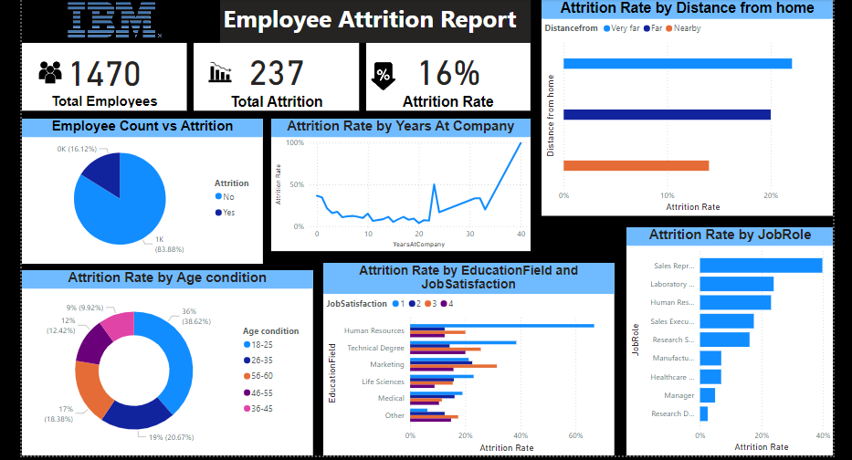
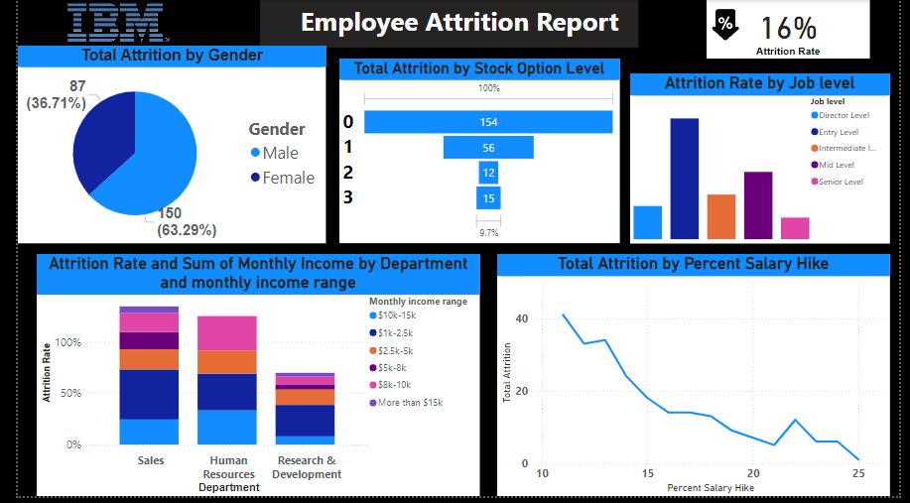
Data Visualisation using PowerBI dashboard:-

Slide 12
1. Total Employees and Attrition Rate:
Total Employees: 1,470
Total Attrition: 237 employees
Attrition Rate: 16%
Analysis: The company's overall attrition rate is moderate at 16%, similar to the first report, which suggests that turnover is an ongoing challenge.
2. Employee Count vs. Attrition:
83.88% (around 1,233 employees) have not left the company.
16.12% (around 237 employees) have left.
Analysis: The majority of employees stay with the company, but the 16.12% attrition suggests that a significant number of employees are still leaving.
3. Attrition Rate by Years at Company:
Attrition is relatively low for employees with fewer than 10 years of service.
There is a notable spike in attrition for employees with over 20 years of service.
Analysis: Longevity doesn’t necessarily equate to retention. Employees with over 20 years at the company seem more likely to leave, possibly due to retirement or other opportunities.
4. Attrition Rate by Distance from Home:
Very Far: Higher attrition rate.
Nearby: Lower attrition rate.
Analysis: Distance from home affects employee retention, with employees who live far from work more likely to leave, potentially due to commuting difficulties.

Slide 13
5. Attrition Rate by Age Condition:
Age 18–25: 9% attrition.
Age 26–35: 36% attrition (highest).
Age 36–45: 19% attrition.
Age 46–55: 17% attrition.
Age 56–60: 12% attrition.
Age 60+: 9% attrition.
Analysis: Younger employees (especially 26-35 years old) are most likely to leave, possibly due to career growth opportunities or dissatisfaction. Older employees (especially 56 and above) tend to have a lower attrition rate.
6. Attrition Rate by Job Role:
Sales Representatives: Highest attrition rate.
Laboratory Technicians and Human Resources: Moderate to high attrition.
Managers and Research Directors: Lower attrition rates.
Analysis: Sales-related roles seem to have the highest turnover, suggesting potential dissatisfaction or higher mobility. More senior positions like managers and research directors see better retention.
7. Attrition Rate by Education Field and Job Satisfaction:
Human Resources and Technical Degree: Higher attrition, especially with lower job satisfaction scores (1–2).
Life Sciences and Medical: Lower attrition overall, with employees generally showing higher satisfaction (scores of 3–4).
Analysis: Education fields like HR and Technical roles may need attention in terms of job satisfaction and retention efforts. Life Sciences and Medical fields appear more stable.

Slide 14
8. Total Attrition by Gender:
Males: 63.29% (150 individuals)
Females: 36.71% (87 individuals)
Analysis: Males experience a significantly higher attrition rate compared to females.
9. Total Attrition by Stock Option Level:
Stock Option Level 0: 154 employees
Stock Option Level 1: 56 employees
Stock Option Level 2: 12 employees
Stock Option Level 3: 15 employees
Analysis: The majority of employees who left had no stock options (Level 0), suggesting that stock options may have a correlation with retention.
10. Attrition Rate by Job Level:
Director Level: Lowest attrition
Entry Level: Highest attrition
Intermediate Level: Moderate attrition
Mid Level: Moderate to high attrition
Senior Level: Lower attrition
Analysis: Entry-level positions experience the highest attrition rate, possibly due to career transitions or dissatisfaction at the beginning of employment. Senior and Director levels have lower attrition, which could indicate greater job stability or satisfaction.

Slide 15
11. Attrition Rate and Monthly Income Range by Department:
Sales: High attrition, mostly in the $2k–$5k income range.
Human Resources: High attrition, especially in the $8k–$10k range.
Research & Development: Relatively lower attrition, with a concentration in the $5k–$8k and $8k–$10k ranges.
Analysis: Sales and HR departments have higher attrition, possibly due to role stress or workload, with varying income ranges playing a role. Research & Development appears more stable.
12. Total Attrition by Percent Salary Hike:
As the percent salary hike increases, attrition generally decreases.
Peak attrition is seen at a salary hike of around 10%.
Analysis: Employees who receive higher salary hikes are less likely to leave, suggesting that salary increases can help with retention.
13. Overall Attrition Rate:
The overall attrition rate is 16%.
Analysis: This shows a moderate turnover rate for the company, with room to improve retention strategies, especially in critical areas like stock options and salary hikes.

Slide 16
Data Analysis:-
Male employees are more likely to leave compared to female employees.
Stock options appear to influence retention, with those having no stock options being more likely to leave.
Entry-level positions and Sales & HR departments face the highest turnover, which may need targeted retention efforts.
Salary hikes have a strong impact on reducing attrition.
Employees aged 26-35 and those working as sales representatives are the most prone to leaving the company, indicating a need for targeted retention strategies in these areas.
Long-tenured employees, particularly those with over 20 years at the company, are also at risk for attrition, which may be linked to retirement or job fatigue.
Distance from home plays a critical role in employee retention, with those living far from work more likely to leave.
Job satisfaction is strongly tied to education fields and roles, with lower satisfaction correlating to higher attrition rates, especially in Human Resources and Technical fields.

Slide 17
THANK YOU

